Slide 1
MOVIE DATABASE COLLECTION
By Baudelio Perez
CSE 111 – 06L

Slide 2
SYSTEM DESCRIPTION
This application is known simply as the “Movie Database Collection”, but it can also be referred to as the “S.U.S Movie Database Collection.”
Users can log into this online application to purchase any film that is stored within the database. However, this database isn’t just set solely for film purchasing. It includes the other following features:
Create user account and operate within specific account only
Manage purchases and view list of purchases
Create, edit, and update lists of films that help with following:
To keep track of which films you have seen registered in the database.
To keep track of which films you wish to watch or own, but have not yet seen
Explore list of all actors and their basic information.
Give films your own personal rating and integrate it within the database.
Add films that were once deemed lost in a previous point in time.
Add any film to database that was not previously present.

Slide 3
IMPLEMENTATION
The only program used for this project was Visual Studio Code. Languages that were utilized during development were SQLite, Java, and the Java JDBC system which allows connectivity between SQLite and Java.
The entire database was developed from scratch with every table being filled in manually combined with the task of perusing information details about specific films included in the database. However, the choice of attributes for each table in the database has taken inspiration from other tables that I have explored on websites such as Kaggle.
In the Java file, I programmed most functions to have connections with only one specific table of the database (i.e., Scores function in Java is only tied to the Scores table from the SQLite database used). Although two or three of these functions have connection with at least one other table from the database only for purposes of updating information across multiple tables. This is due to specific tuples having the exact same set of information across more than one table (i.e., m_title (from movies) = x_title (from watched))

Slide 4
USER-CASE DIAGRAM INTERACTIONS
The most important interactions between the interface and the user would be:
User being able to purchase movies from database.
Modifying and updating information pertinent to their account:
Information present in their list of purchases.
Information present in films that have already been watched
Information present in films that have been set on a “Wish List”
Aggregating lost or new films to the database. Though it is highly preferred that films be added that they be films that were considered “lost” at some point in time.

Slide 5
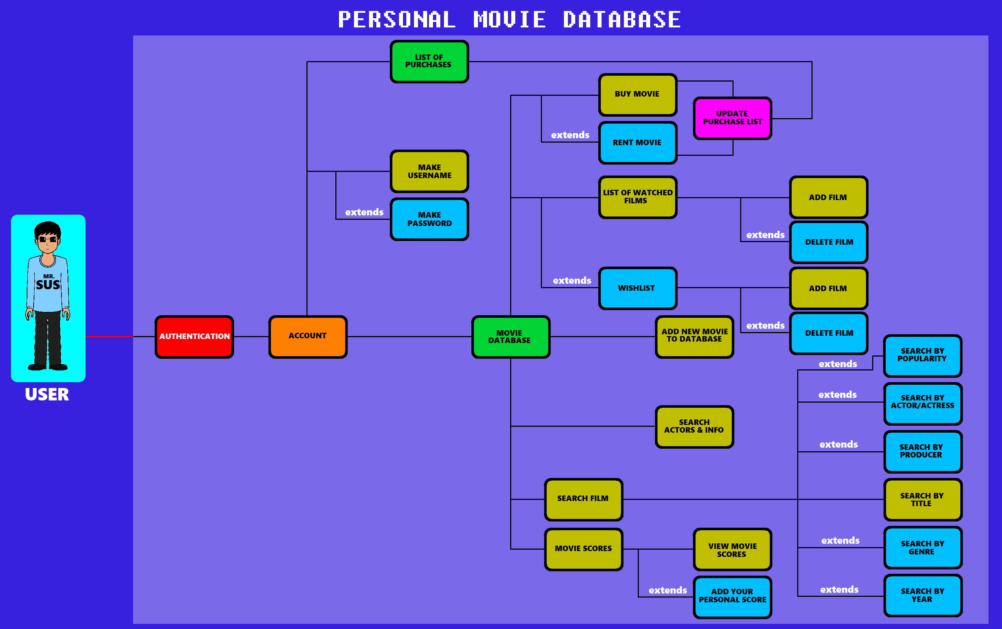
UML USE-CASE DIAGRAM
The “buy/rent” option has been reduced to just “buy” or “purchase” for a film.

Slide 6
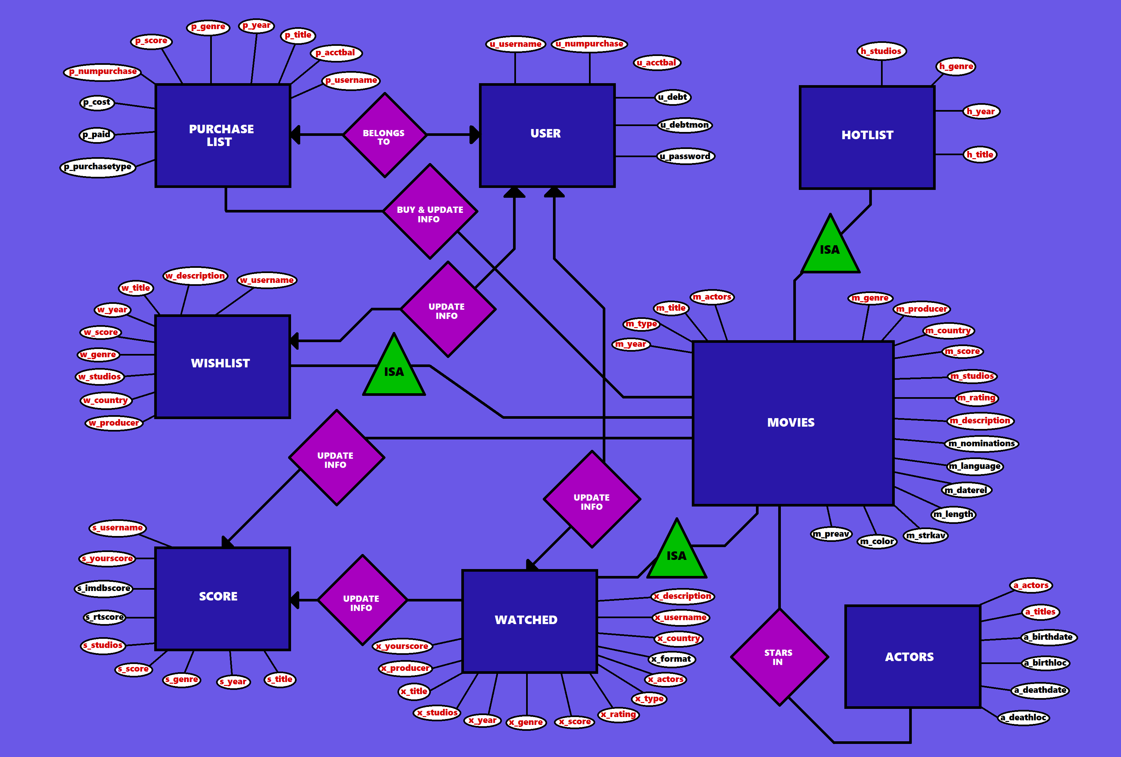
E/R DIAGRAM
NOTE:
x_country has been eliminated from “WATCHED” table. Deemed unnecessarily included…

Slide 7
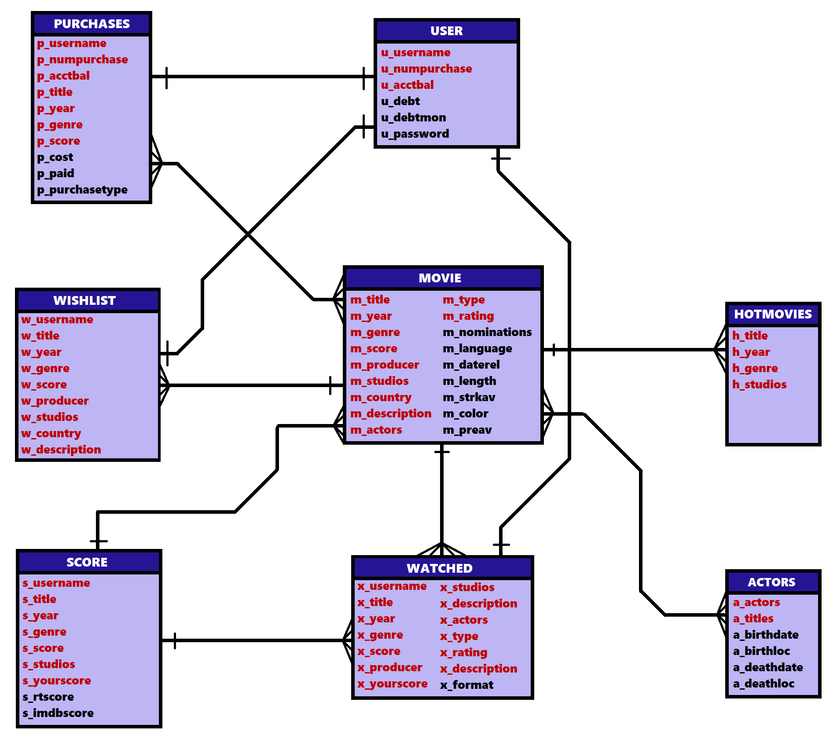

RELATIONAL SCHEMA
x_description is
the same variable…

Slide 8
RELATIONAL SCHEMA (Continued)
USERACC
u_username (PRIMARY KEY), u_numpurchase, u_acctbal, u_debt, u_debtmon, u_password
PURCHASES (weak entity)
p_username, p_numpurchase, p_acctbal, p_title, p_year, p_genre, p_score, p_cost, p_paid, p_purchasetype
MOVIE
m_title (PRIMARY KEY), m_year, m_genre, m_score, m_producer, m_studios, m_country, m_description, m_actors, m_type, m_rating, m_nominations, m_language, m_daterel, m_length, m_strkav, m_color, m_prevav
WISHLIST (weak entity)
w_username, w_title, w_year, w_genre, w_score, w_producer, w_studios, w_country, w_description
WATCHED (weak entity)
x_username, x_title, x_year, x_genre, x_score, x_producer, x_yourscore, x_studios, x_actors, x_type, x_rating, x_description, x_format
SCORE (weak entity)
s_username, s_title, s_year, s_genre, s_score, s_studios, s_yourscore, s_rtscore, s_imdbscore
HOTMOVIES
h_title (PRIMARY KEY), h_year, h_genre, h_studios
ACTORS
a_actors (PRIMARY KEY), a_titles, a_birthdate, a_birthloc, a_death, a_deathloc

Slide 9
DEFINITIONS
UserAcc – essentially the account of the user for authentication purposes.
Movies – the massive repository containing information of the many films that have been brought out into existence. You can add new or rediscovered films to the database as well.
Purchases (weak entity) – option to view purchases that have been made on your account. Also includes feature to purchase a film.
Wishlist (weak entity) – personalized list of films you haven’t seen but wish to see.
Score (weak entity) – repository containing film titles and the scores they have received through score reception databases like Rotten Tomatoes or IMBD. You can also add your own personalized score.
Watched (weak entity) – personalized list of films you have already watched and/or own.
Hotlist – sub list of Movies repository containing only the movies that are trending.
Actors – list of actors who participated in movies listed in the database and includes small facts about their life (i.e., birth and death).

Slide 10
FUNCTIONS (screenshots and explanations)

Slide 11
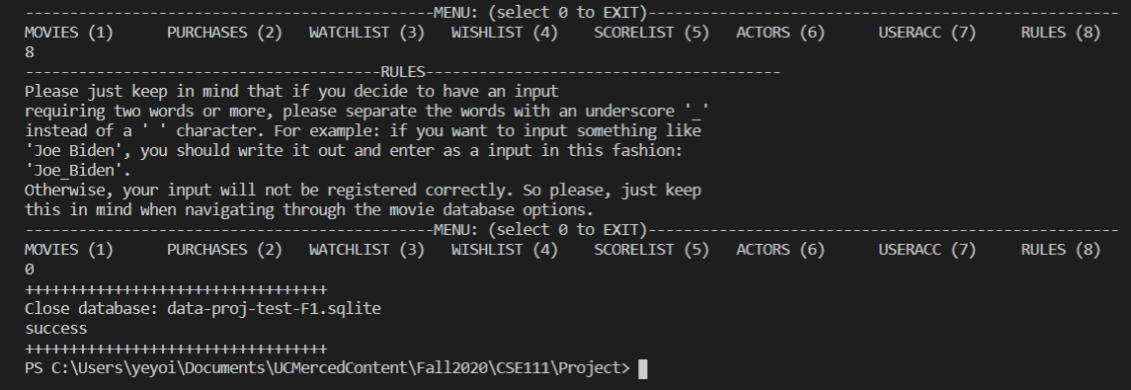
FUNCTION #8 – Input Rules
Rules – a simple instruction on how to properly type input responses.
The reason I included this was due to having testing issues with input values involving two or more words separated by a space character (‘ ‘). Typing in “Joe Biden” as an input gets registered into “Joe” only. And at the time I realized this, all of my information in each table had collections of words separated by spaces. So, I had to manually change all information with underscore characters “_” replacing space characters. Then the user could input information in functions and get the correct and expected results.

Slide 12
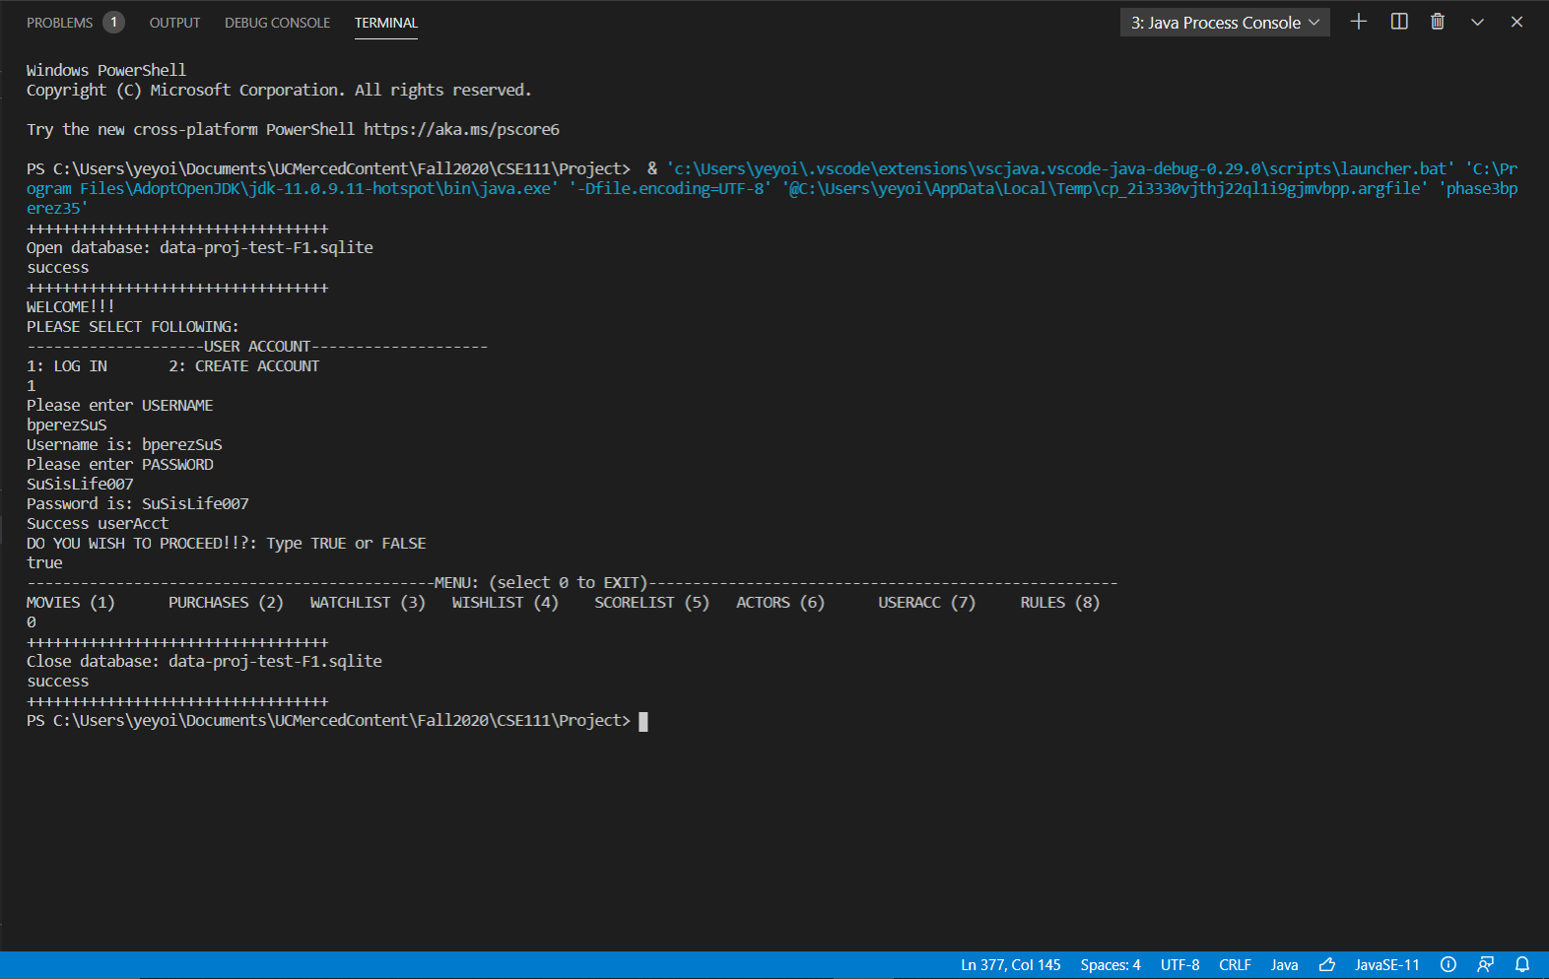
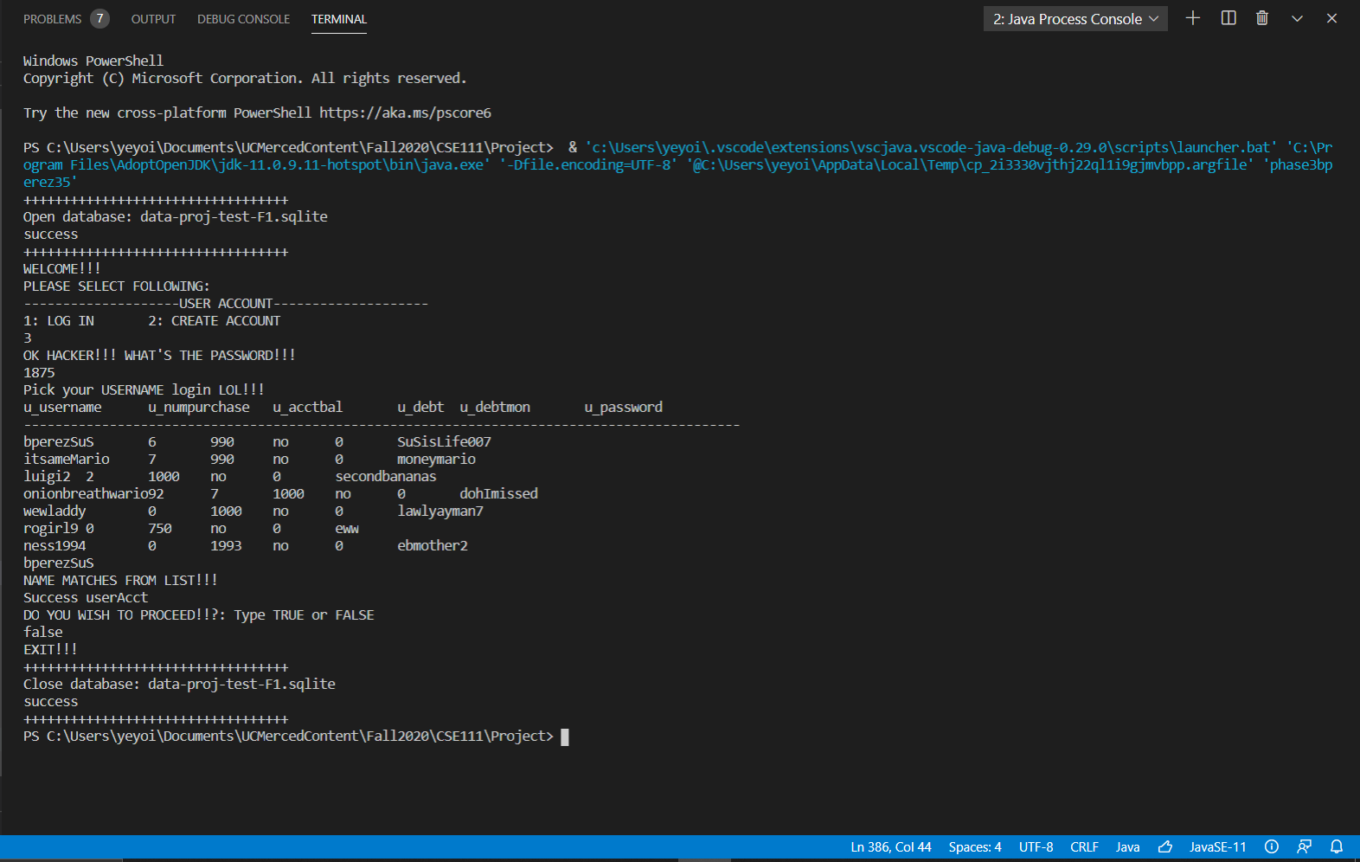
FUNCTION #7 – Security and Log In
Security Measures – to use and navigate database, you need to create an account. If you can’t log in, then the system will not let you into the database unless if you consider the option of creating an account which is offered.
Pressing “1” allows a person to login with a username and a password. Then the program will search for values in userAcc table and match them with the input. If there is a match, then the login occurs. If not, then no entrance to the app.
I also added a secret function that allows you to see how many user accounts are available in the database. This can be done by pressing “3”. You can use this to “cheat” your way into a successful login if you press “true” instead of “false”.

Slide 13
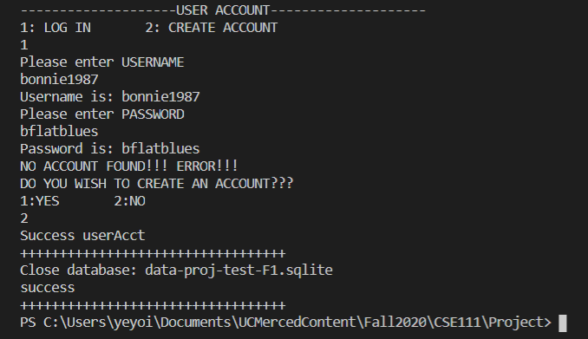
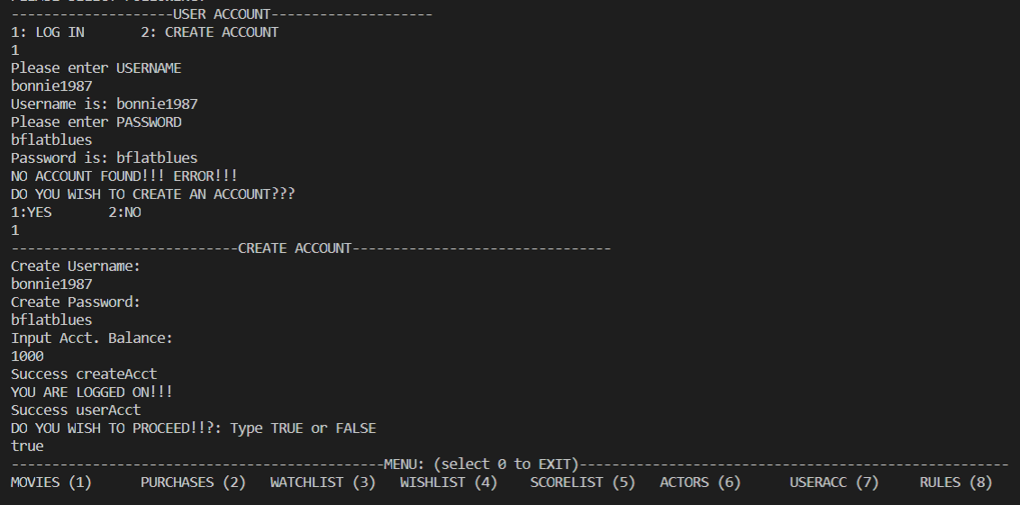
FUNCTION #7 – Security and Log In
Security Measures – to use and navigate database, you need to create an account. If you can’t log in, then the system will not let you into the database unless if you consider the option of creating an account which is offered.
DECLINE AND EXIT
(bonnie 1987) not created
ACCEPT AND LOGIN
(bonnie1987) created
If a person attempts to enter user account information not present in the secret userAcc table, then you are given the option to either create an account and login. But you are also given the option to decline and exit the program.

Slide 14
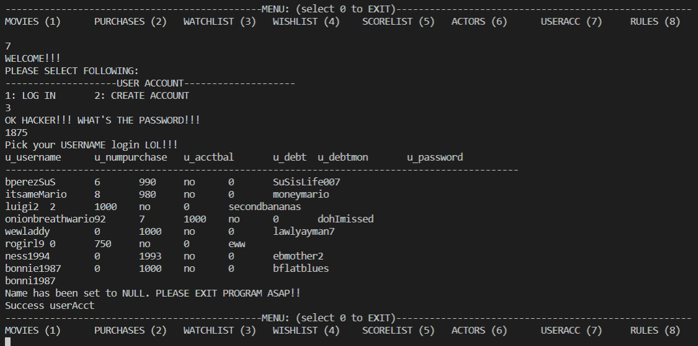
FUNCTION #7 – Security and Log In
Security Measures – to use and navigate database, you need to create an account. If you can’t log in, then the system will not let you into the database unless if you consider the option of creating an account which is offered.
And if we activate the secret menu, we notice that “bonnie1987” has been added as a new account for database use.
NOTE:
For the secret feature, I wanted to make this option a little humorous. A false response would have brought a statement that would say, “NICE TRY MACK!!!” and have the user automatically exit the app.

Slide 15
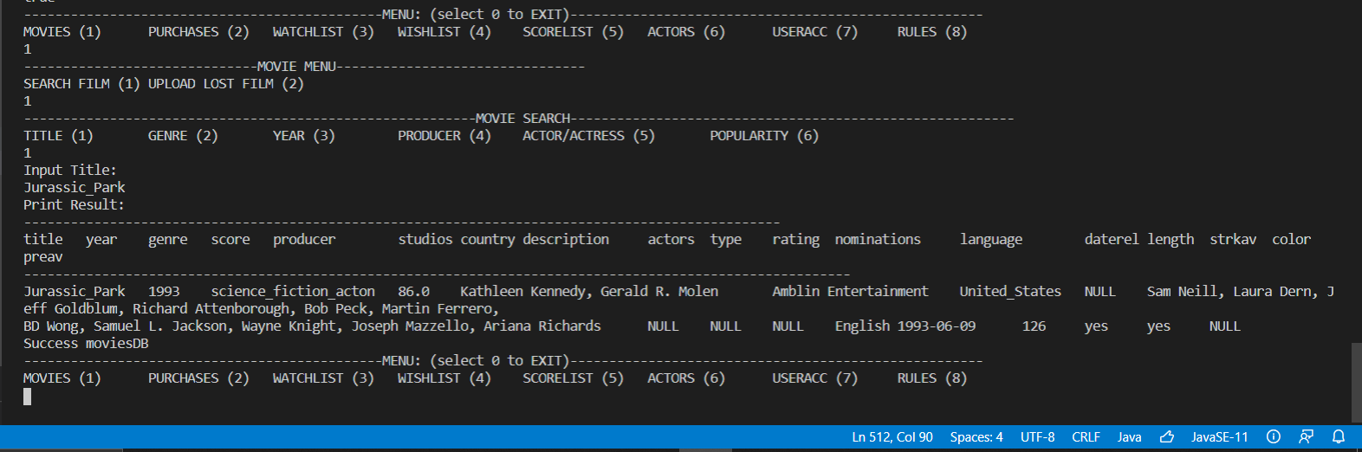
FUNCTION #1 – Movie Search & Update
Movie List – the main database where all movies available for browsing and purchasing are contained. Movies not in the default list can also be added.
The “movies” function allows the user to search and see what movies are present in the main database as well as the information attributed to that film. The search can be filtered out by the following: title, genre, year, producer, actor/actress, or popularity. The graphic above demonstrates a search with filtering by title name.

Slide 16
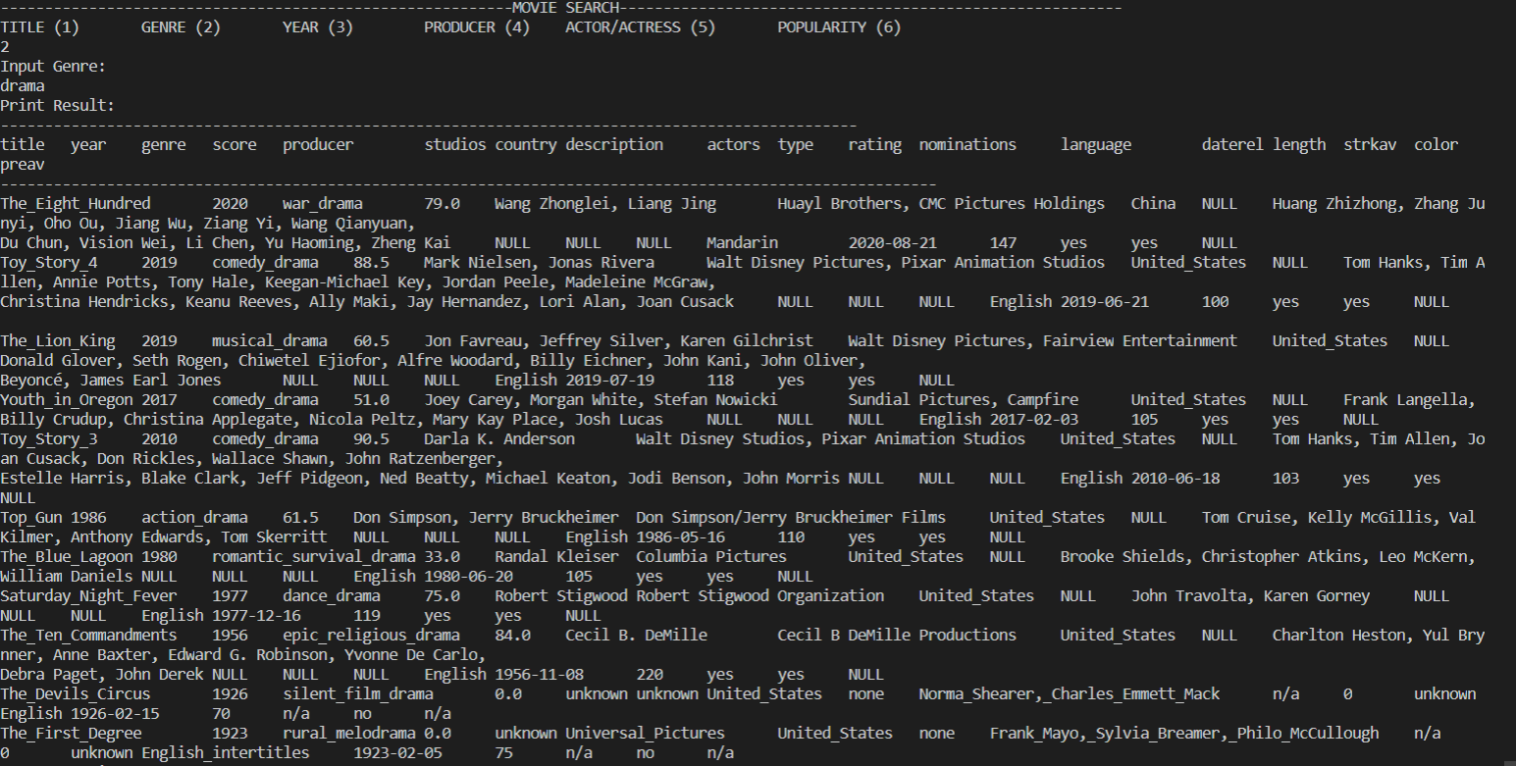
FUNCTION #1 – Movie Search & Update
Movie List – the main database where all movies available for browsing and purchasing are contained. Movies not in the default list can also be added.
Here is an example of a search conducted by genre. The user is looking for films of anything related to “drama”. Notice how many tuples are printed as a result. And these tuples display films of a great variety of drama sub-genres, such as:
“war_drama”, “comedy_drama”, “epic_religious_drama”, “rural_melodrama”, etc.

Slide 17
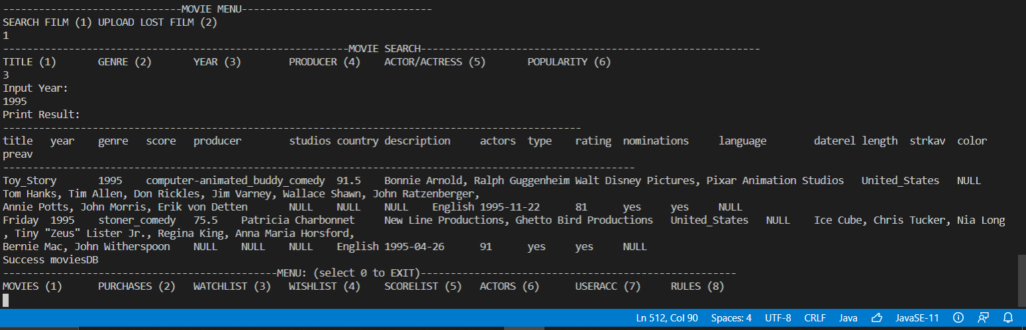
FUNCTION #1 – Movie Search & Update
Movie List – the main database where all movies available for browsing and purchasing are contained. Movies not in the default list can also be added.
Search for a movie filtered out by a year. In this case, “1995”

Slide 18
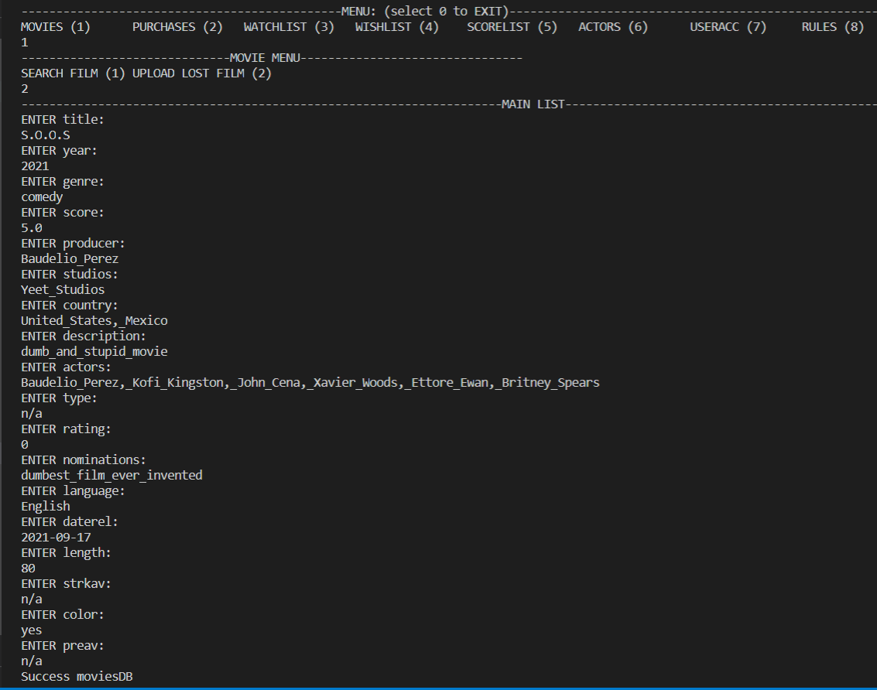
FUNCTION #1 – Movie Search & Update
Movie List – the main database where all movies available for browsing and purchasing are contained. Movies not in the default list can also be added.
Though the “Movies” function is not limited to browsing, as the user can also add other films that were not initially present in the database.
Although one can technically add any kind of film to the main database, I would like to encourage adding films that were previously considered lost for reasons of preservation (i.e., 1920s lost silent films).
And please attempt to avoid adding fake films that don’t exist in any way, shape, or form like in the example to the left.

Slide 19
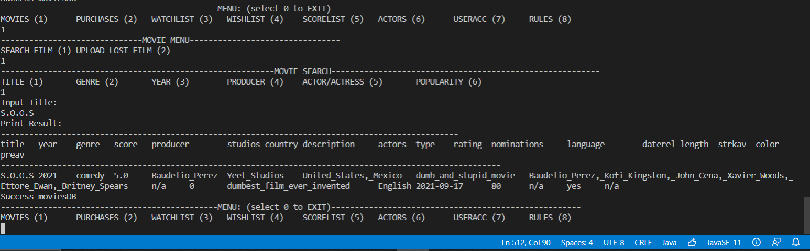
FUNCTION #1 – Movie Search & Update
Movie List – the main database where all movies available for browsing and purchasing are contained. Movies not in the default list can also be added.
Custom additions that have been added can be searched for by the user who committed the update, or by any other user that has an account registered for this application.

Slide 20
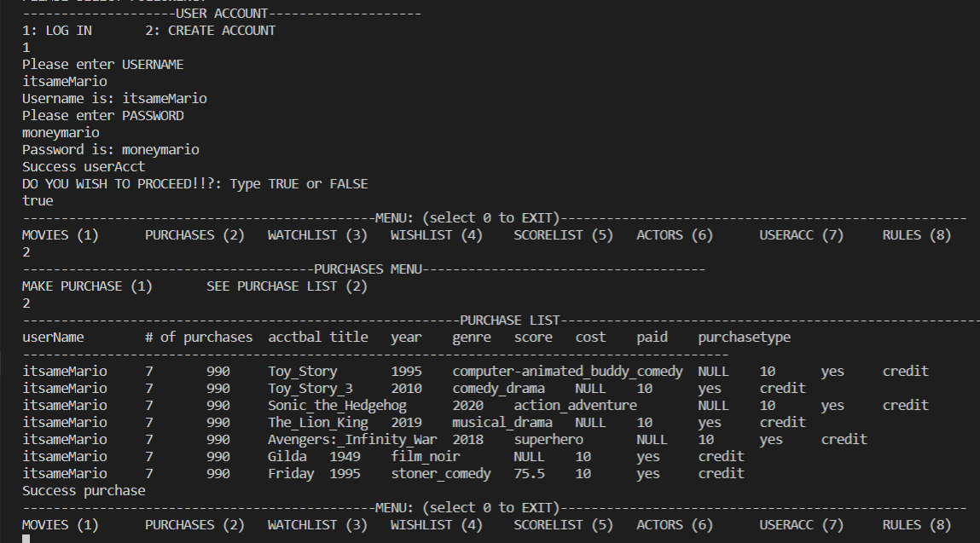
FUNCTION #2 – Purchase List
Purchase List – the list useful for keeping track of how many purchases you have made. It can also be updated once a new purchase has been made.
In the “Purchases” option, the user can view his/her purchase list or update it by making a purchase.
In the case of “itsameMario”, we can see that he contains:
7 purchases
$990 in account balance “acctbal”
Specific title of film purchased
Year film was released
Genre and average score of film
Cost of the film (each $10)
A notice of whether film was paid
How the purchase was made (i.e. Credit)

Slide 21
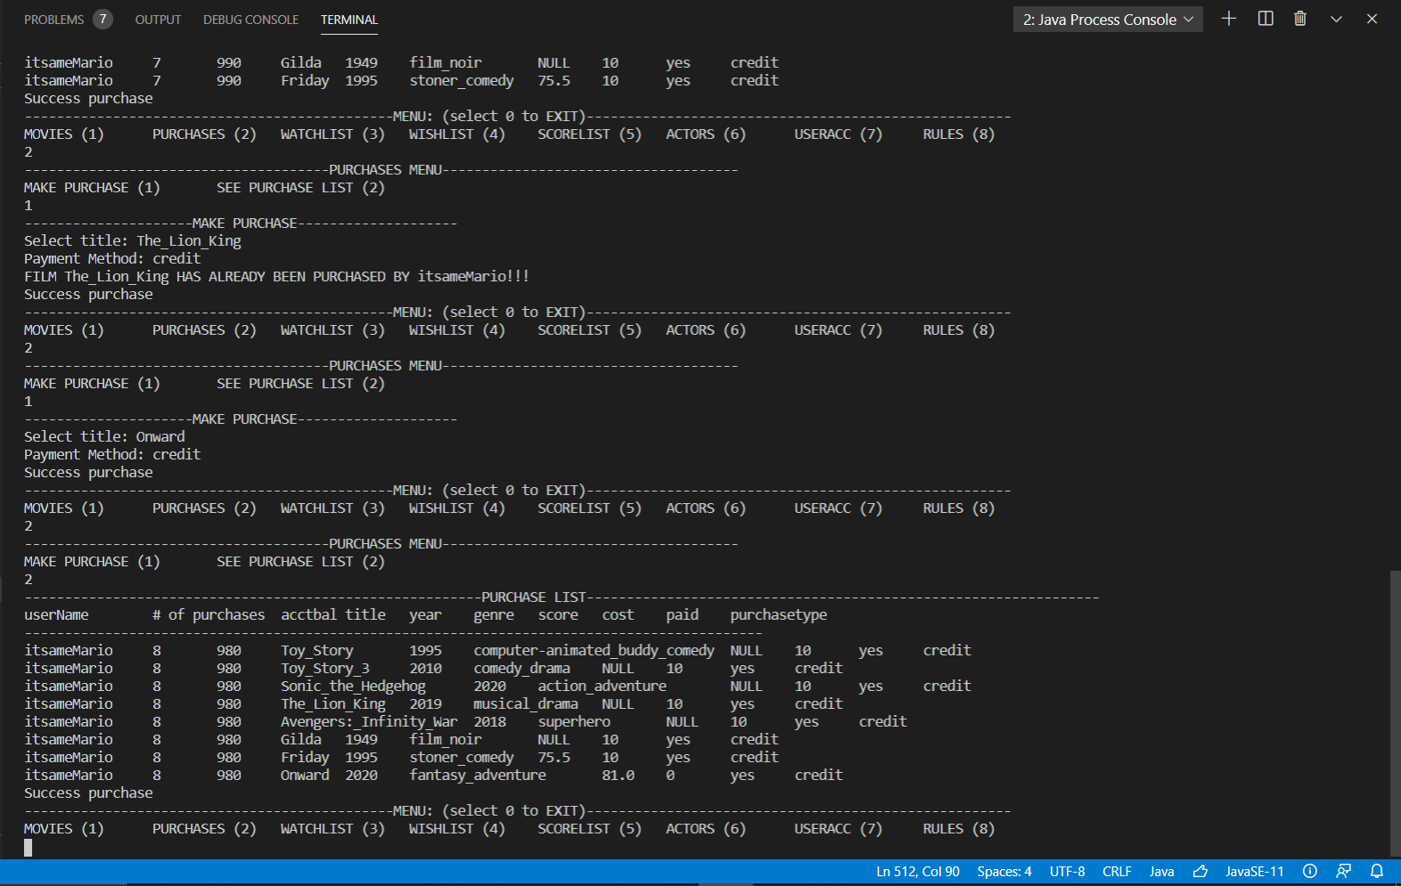
FUNCTION #2 – Purchase List
Purchase List – the list useful for keeping track of how many purchases you have made. It can also be updated once a new purchase has been made.
When making a purchase, the user can select the title he/she wishes to purchase as well as the payment method that the user wants to use.
Then the user’s purchase list gets updated with the # of purchases changing as well as the account balance “acctbal”. “itsameMario” now has 8 purchases with the film “Onward”. And has his account balance reduced by $10.

Slide 22
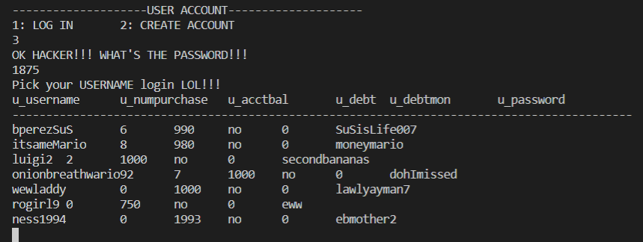
FUNCTION #2 – Purchase List
Purchase List – the list useful for keeping track of how many purchases you have made. It can also be updated once a new purchase has been made.
We also notice that the information in the “secret User Account” table has been updated as well to match the information present in the respective purchase lists of each user in this database application.
u_numpurchase and u_acctbal of “itsameMario” has been updated to have the same values as the variables numpurchase and acctbal in the “purchases” menu.
For each row in userAcc, properties are listed in this order:
u_username | u_numpurchase | u_acctbal | u_debt | u_debt_mon | u_password

Slide 23
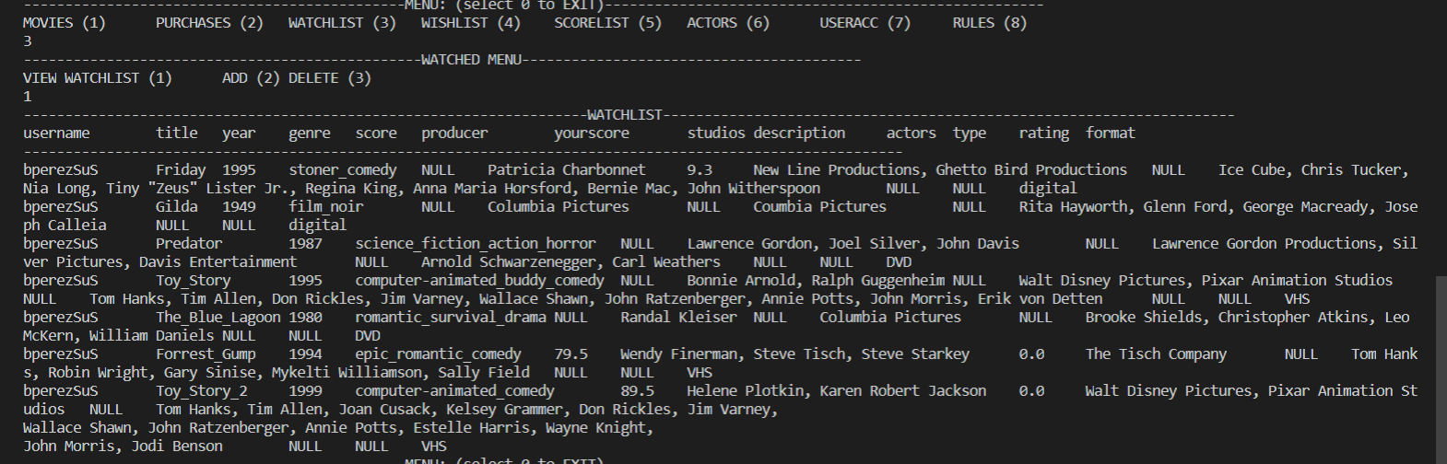
FUNCTIONS #3 & #4 – WatchedList and Wishlist
Watched List & Wishlist – lists that keep track of movies that you have seen and movies that you wish to see, respectively.
This “watchedlist” belongs to account user “bperezSuS” (me). Though keep in mind that the entire “watched” (from the original database) contains a collection of tuples relevant to all users registered in this database. Though the programming only allows certain tuples to be viewed depending on the user that logged on. So in this case, “bperezSuS” can only see his list of films that he has already watched and can’t SEE the films that “itsameMario” has SEEN.

Slide 24
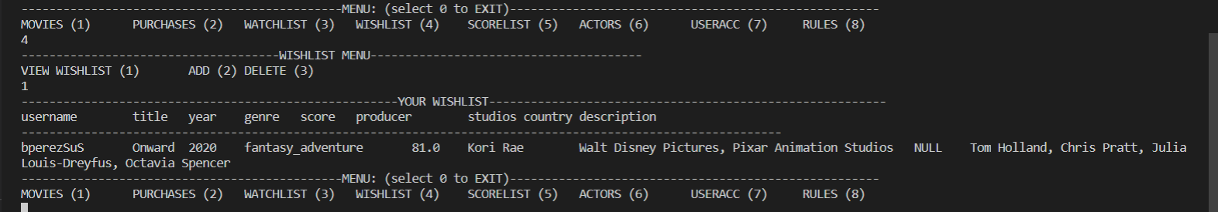
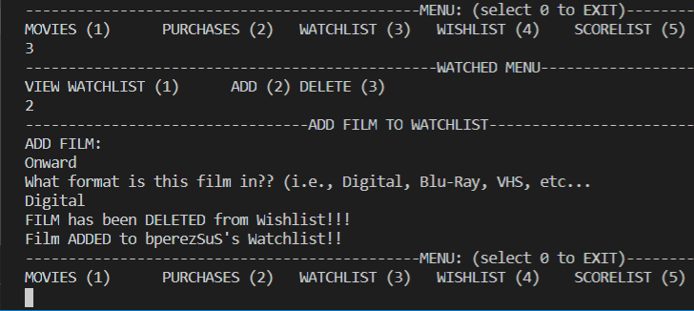
FUNCTIONS #3 & #4 – WatchedList and Wishlist
Watched List & Wishlist – lists that keep track of movies that you have seen and movies that you wish to see, respectively.
Likewise, the image above shows “bperezSuS’s” wishlist set with the same restrictions as “watchedlist” mentioned in the previous slide.
Both a “watchedlist” and a wishlist of a user can be affected if the ADD option is elected in the WatchedList Menu. It basically adds a film to the WatchedList table. However, the catch is that if this particular film is also present in the Wishlist, then it will be removed from the wishlist aside from being added to the “watchedlist”. This is because this film has been seen and no longer has any purpose in being film that “hasn’t been seen, but wishes to be seen”.

Slide 25
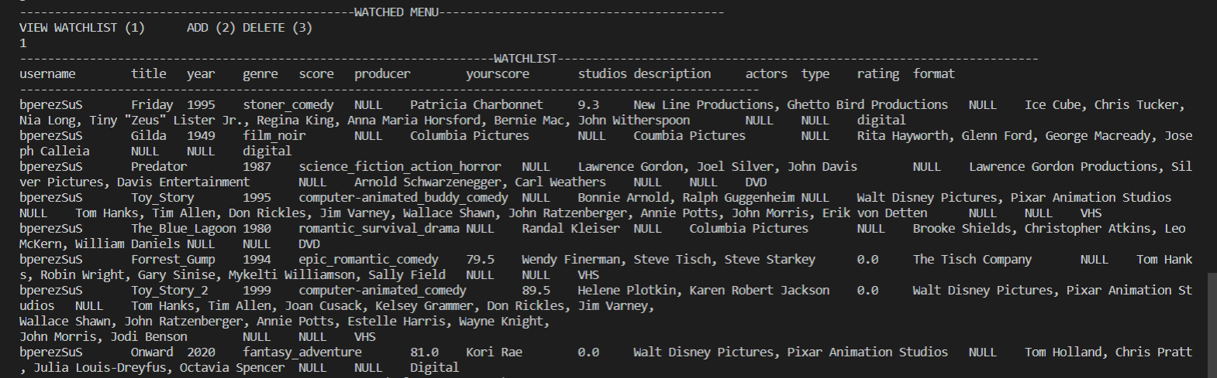
FUNCTIONS #3 & #4 – WatchedList and Wishlist
Watched List & Wishlist – lists that keep track of movies that you have seen and movies that you wish to see, respectively.
This is the end result of “bperezSuS’s” watchedList after the film “Onward” has been added and “seen”.

Slide 26
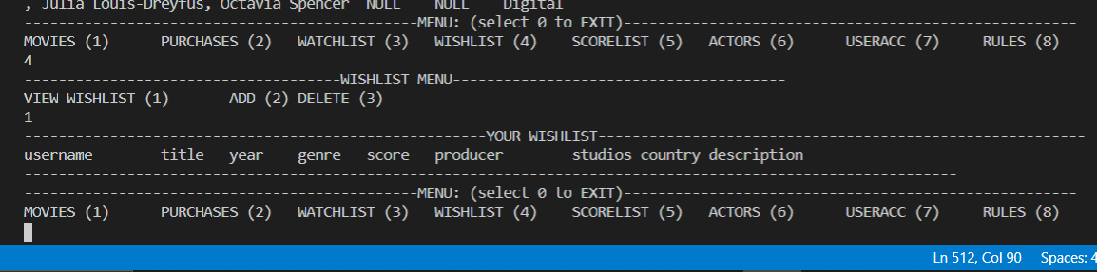
FUNCTIONS #3 & #4 – WatchedList and Wishlist
Watched List & Wishlist – lists that keep track of movies that you have seen and movies that you wish to see, respectively.
Likewise, this is the result of “bperezSuS’s” wishlist. It has been “left empty”. More specifically, the database table from where this information is derived from (“wishlist”) is not literally empty as it contains tuples pertinent to other users. But all tuples involving “bperezSuS’s” wishlist films are no longer present as the tuple that was deleted was the only initially present.

Slide 27
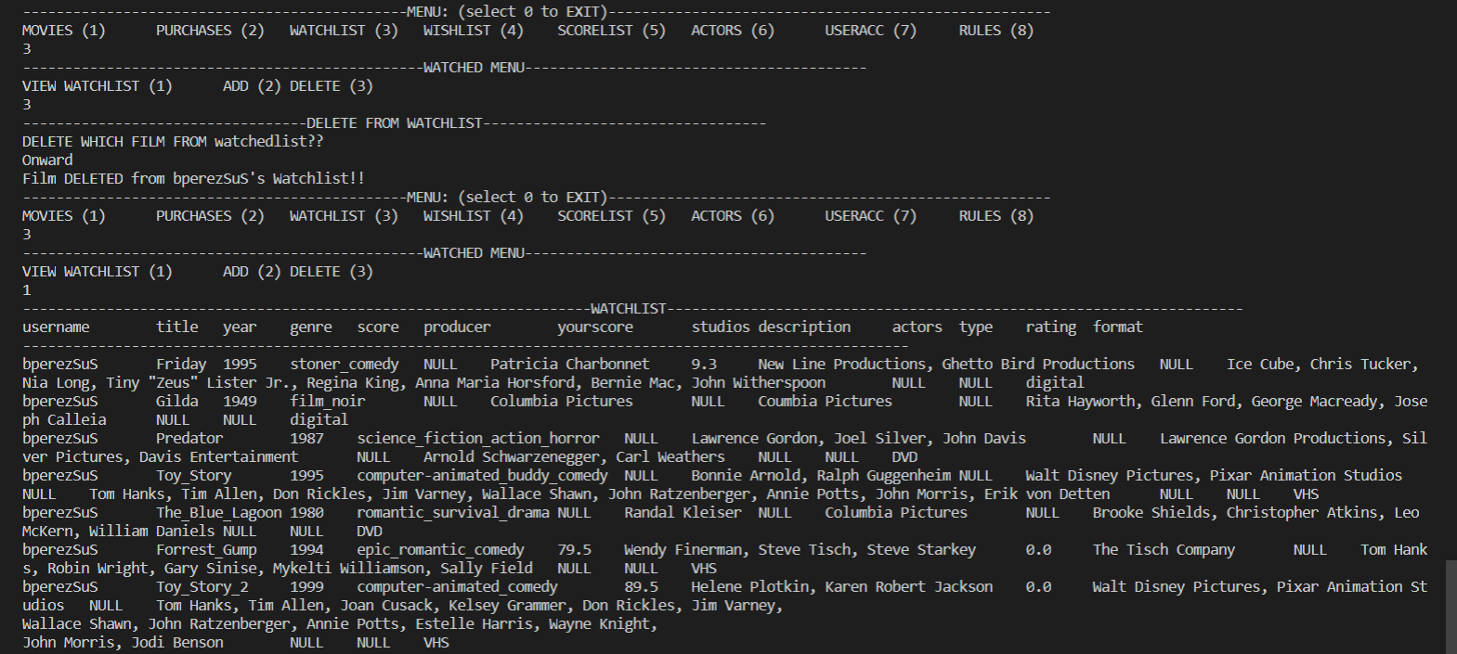
FUNCTIONS #3 & #4 – WatchedList and Wishlist
Watched List & Wishlist – lists that keep track of movies that you have seen and movies that you wish to see, respectively.
“Onward” has been deleted from “bperezSuS”’s watchedList
It is possible to perform the ADD function in both WatchedList and Wishlist without affecting one list or the other. This can be done by adding a film to WatchedList that isn’t present in Wishlist. And adding films on Wishlist has no effect on WatchedList. Performing the DELETE function in either list only deletes a tuple from the table only affecting the list being operated on.

Slide 28
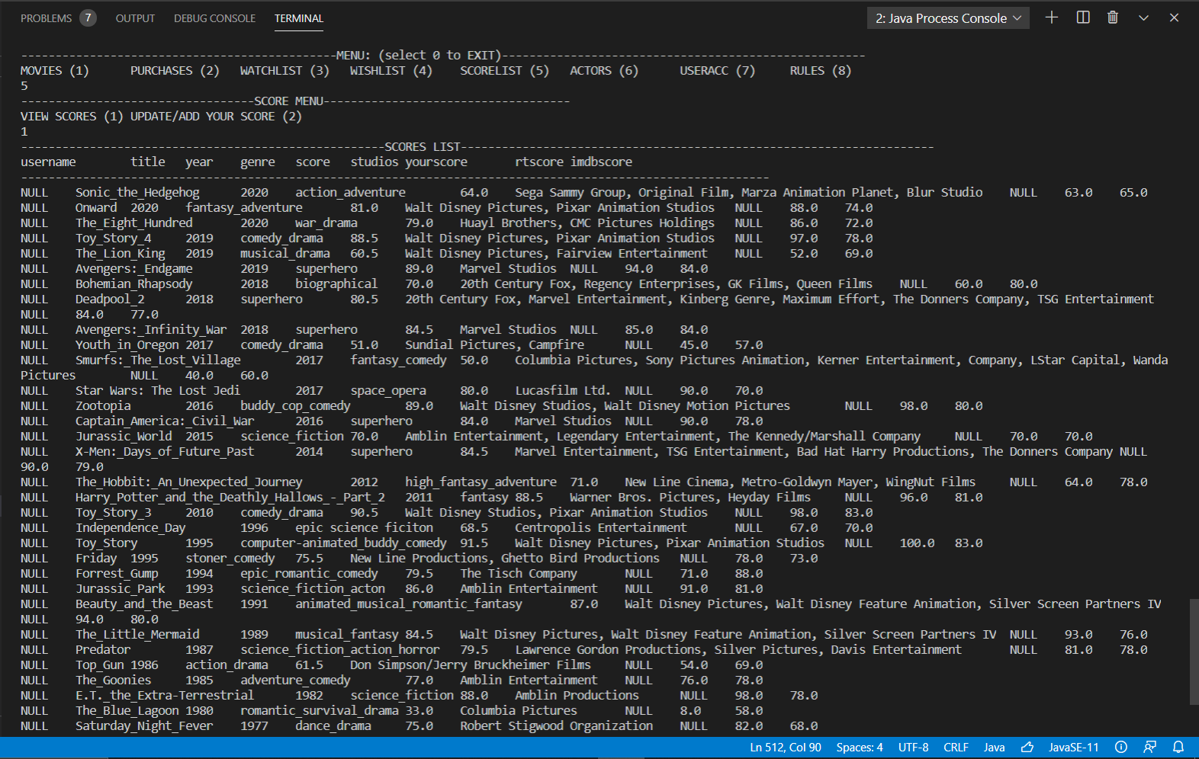
FUNCTION #5 – ScoreList
Scores – copy of movie table database with added functionality for user to aggregate personalized scores for specific films.
For the “score” function, the user has the option to view the entire list of movies from the movie database, but not all 18 columns from the movie table. Just the “necessary” alongside the ones along with the scores set by Rotten Tomatoes (rtscore) and IMDB (imdbscore).
There is also a new tuple called “yourscore” specified for the users personal scoring of a specific film.

Slide 29
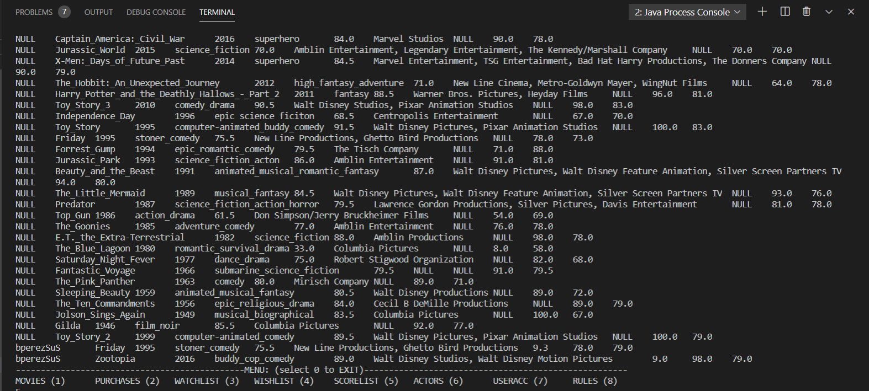
FUNCTION #5 – ScoreList
Scores – copy of movie table database with added functionality for user to aggregate personalized scores for specific films.
Let’s take into consideration the new tuples that have been added to the bottom. If the first column “username” contains “NULL”, then it is a tuple that doesn’t belong to a particular user.
If it contains a name other than “NULL”, then that tuple was entered by a specific user and contains a personal score value known as “yourscore”, which is the third rightmost column value from the last for each tuple.
Tuples set with username = “NULL” don’t have “yourscore” set with a specific value since they are not “personalized” tuples.
As you can see here in this graphic example, user “bperezSuS” has two entries with personal scores for films “Friday” (9.3) and “Zootopia” (9.0).

Slide 30
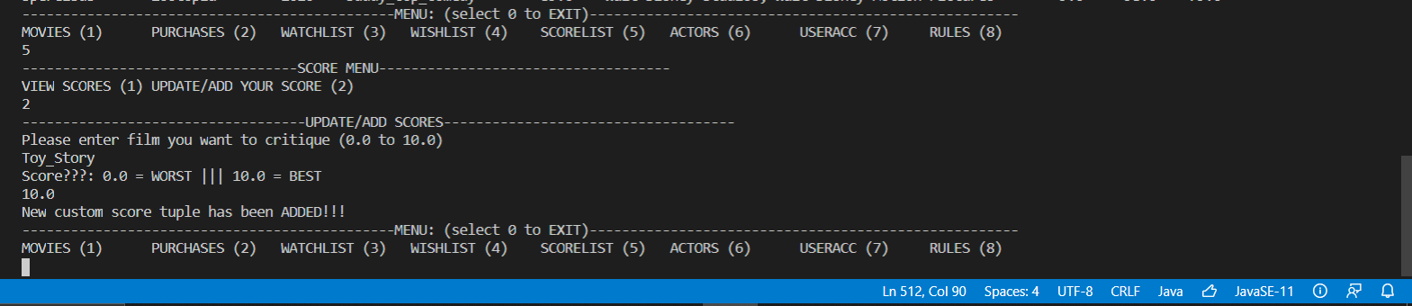
FUNCTION #5 – ScoreList
Scores – copy of movie table database with added functionality for user to aggregate personalized scores for specific films.
The user can add new film tuples with a specific username and a personal score to the ScoreList. In “bperezSuS”’s case, a new tuple with a personal score for the film “Toy Story” has been added. Also, keep note of the personal score set for Zootopia, which is 9.0.

Slide 31
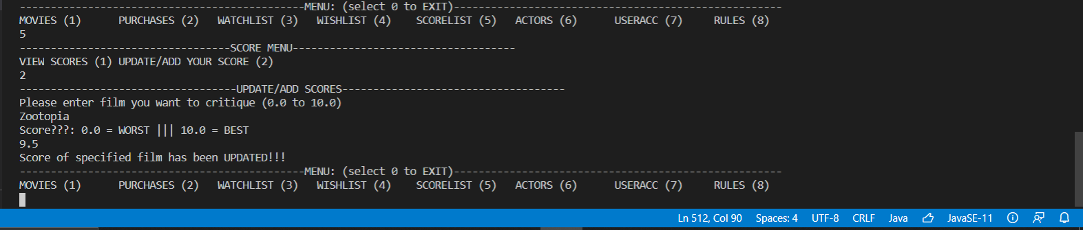
FUNCTION #5 – ScoreList
Scores – copy of movie table database with added functionality for user to aggregate personalized scores for specific films.
If the user decides to give a score to a film that has already been placed into the scoreList, the program does not add another tuple with the same username and “yourscore” value. Rather it searches to find if there exists a tuple with the specific name of the film and just updates the “yourscore” value only in that specific tuple. For instance, “bperezSuS” already had Zootopia set with a score of 9.0. But if he wanted to change the score to 9.5, that same tuple would be modified instead of having another tuple with the same username and information be added to the ScoreList with the new personalized “yourscore” value.

Slide 32
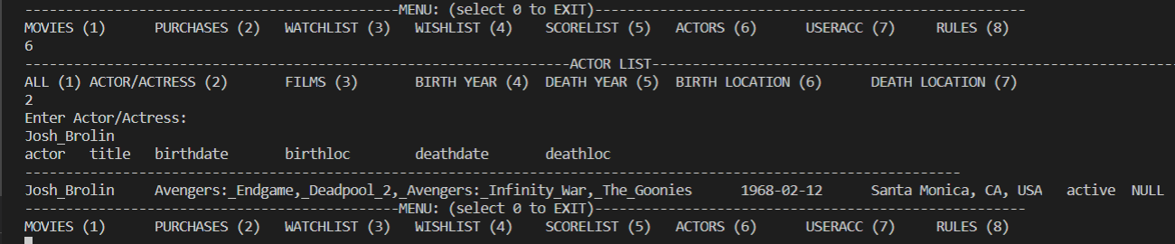
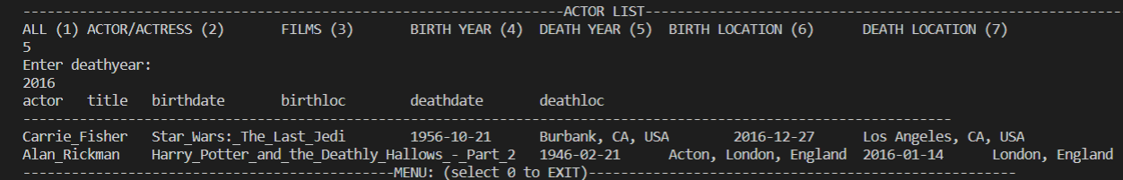
FUNCTION #6 – Actors List
Actors – list of all actors present in all or most films registered in the main movie database located in “MOVIES”.
The “Actors” List function gives the user access to a database akin to the original “Movies” database, except that each tuple involves a specific actor. Each tuple with each actor comes along with their basic information (i.e., birthdate, deathdate, alive/dead status, etc.) Although it cannot be updated or modified like the Movies database, the user can still browse through the database through filtering by specific data columns (i.e, birthdate, deathdate, etc.)

Slide 33
ANY QUESTIONS…??
For Mr. SuS…???

